Slide 1
Chapter 3 – SCM with GitHub

Slide 2
Learning Topics
Launching Server in Cloud
Introduction to SCM
Overview of GitHub
GitHub Terminologies
GitHub Workflow

Slide 3
Lab – Launch Your Server in Cloud
Launch your server
Pre-installed software for all labs
Will be used for GitHub, Docker and Ansible labs
Follow instructions mentioned in lab document

Slide 4
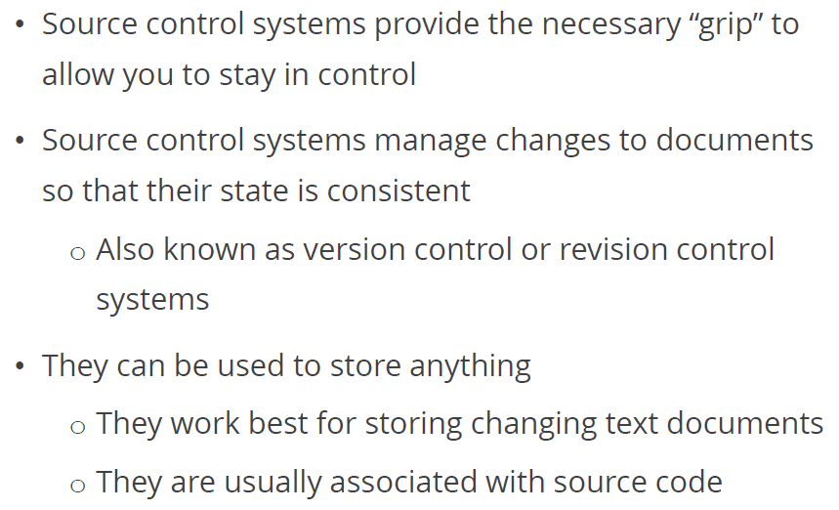
Source Control Systems

Slide 5
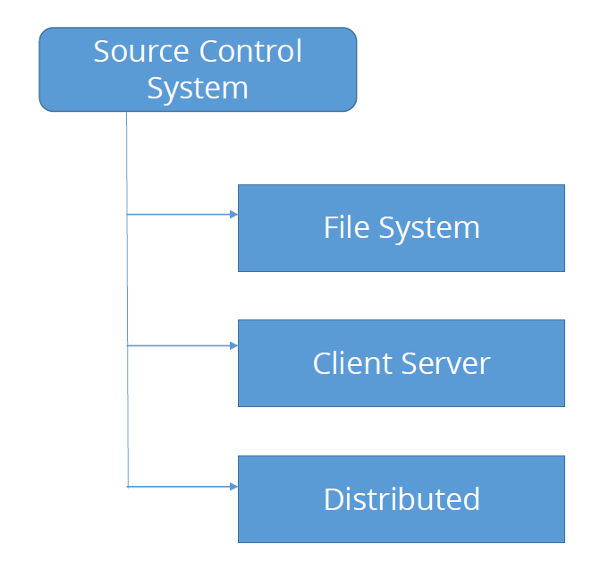
Types of Source Control Systems

Slide 6
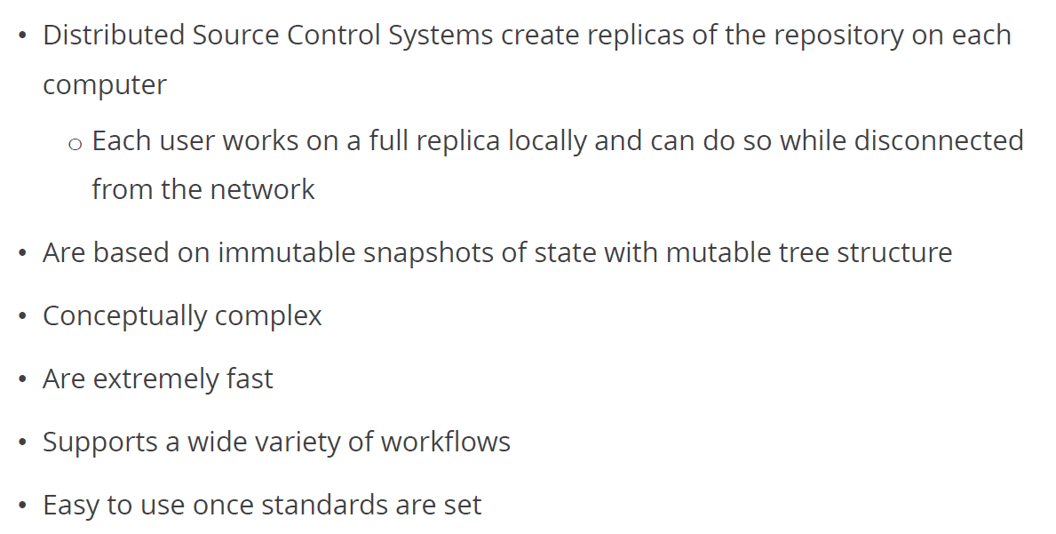
Distributed Source Control Systems

Slide 7
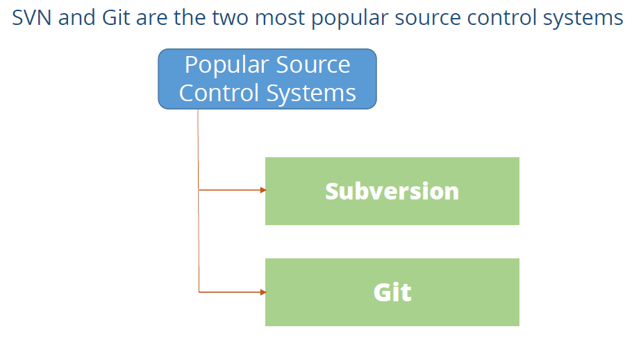
Popular Open Source Control Systems

Slide 8
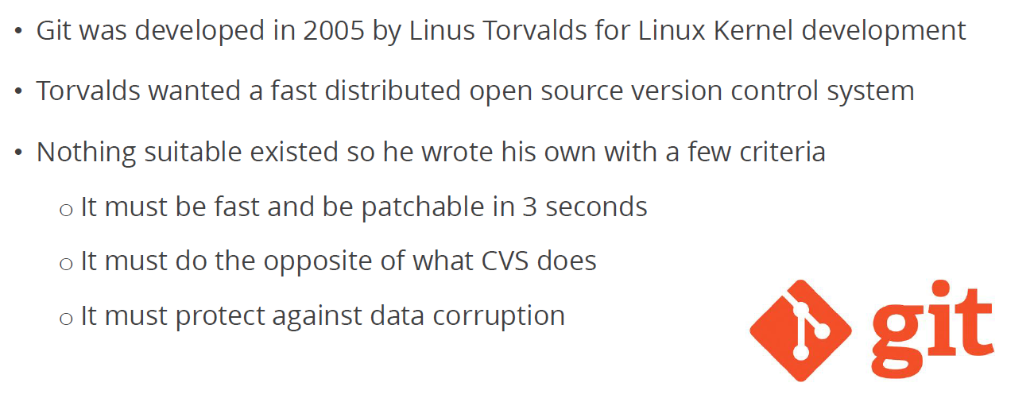
Git

Slide 9
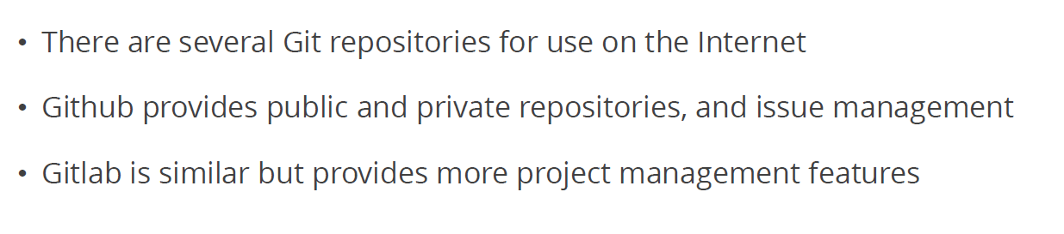
Git Repositories

Slide 10
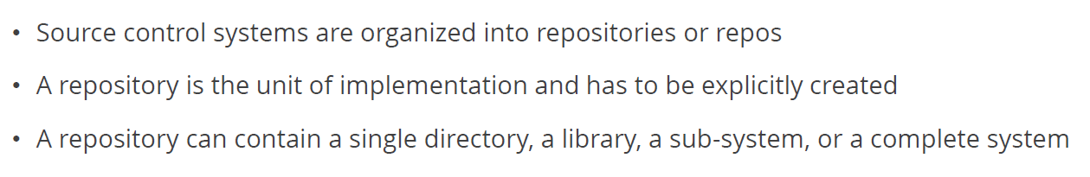
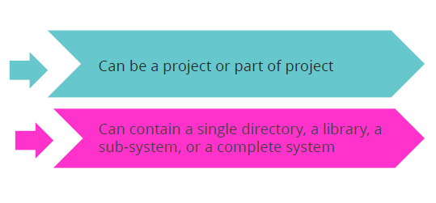
Repositories

Slide 11
Assignment – Create Your Account on GitHub
Create your account on www.github.com
Remember credentials, we’ll need them in labs
https://github.com/albertlovescloud/rildevopstraining

Slide 12
Lab 1 – Set Global Configuration Locally
Create account on www.github.com
Remember credentials, we’ll need them in labs

Slide 13
Lab 2 – Create and Clone Repository

Slide 14
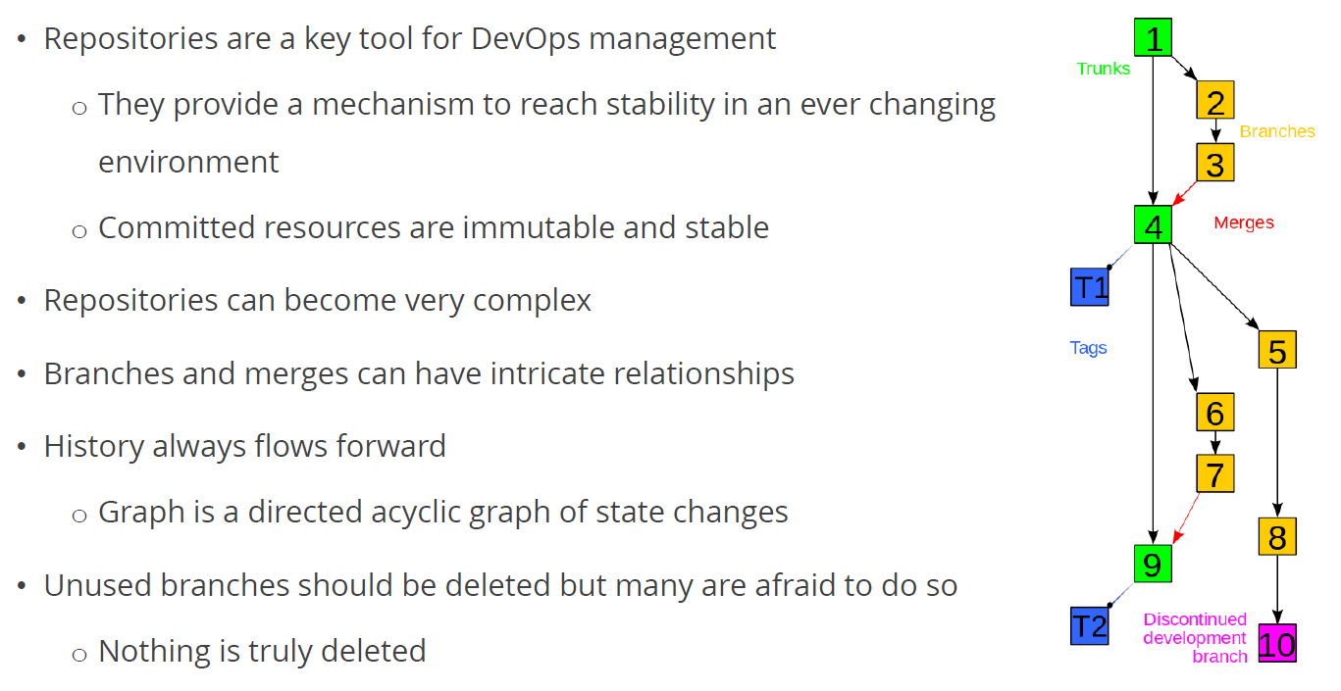
Repositories and DevOps

Slide 15
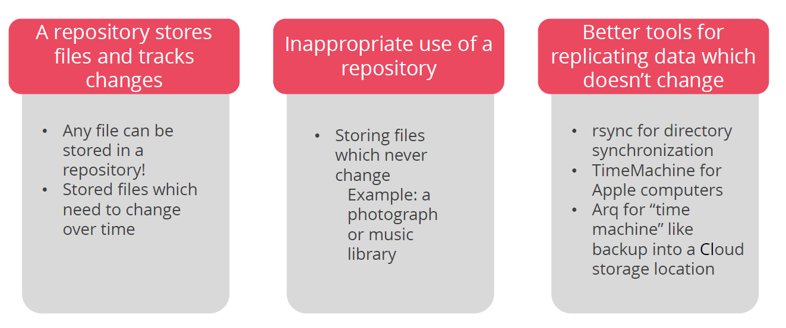
Repositories Best Practices

Slide 16
Lab 3 – Change a File & Save Locally

Slide 17
Lab 4 – Push Changes to Master from Local

Slide 18
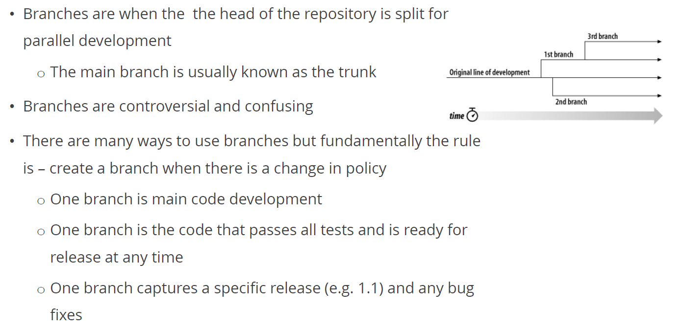
Branches

Slide 19
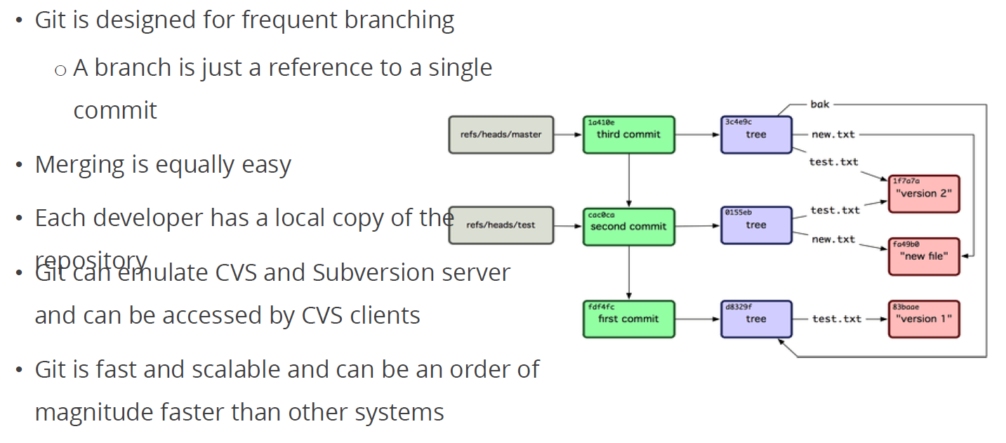
Git Design

Slide 20
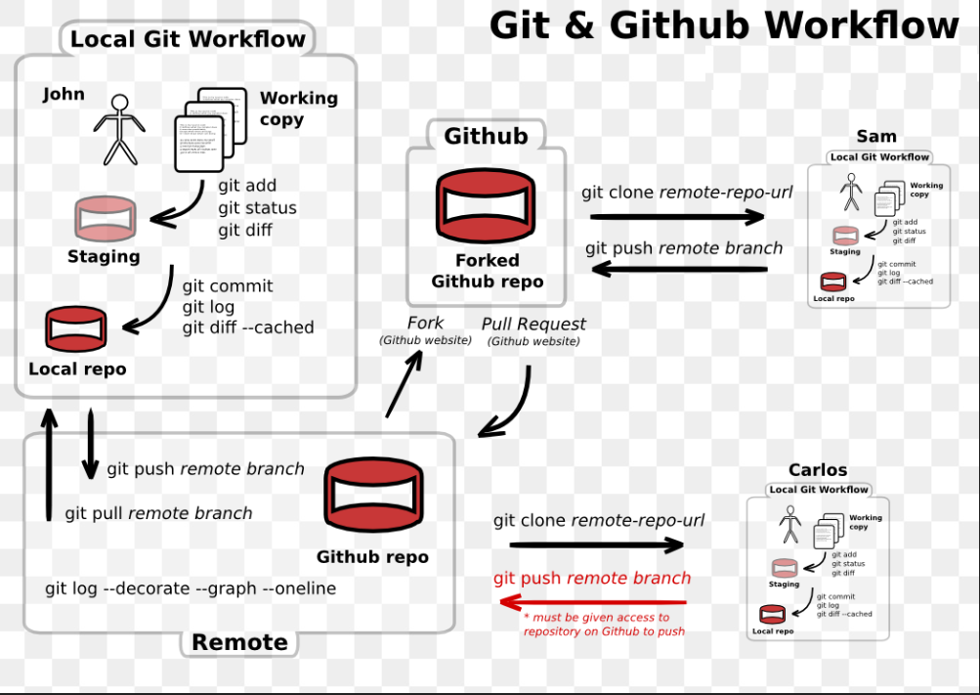

Slide 21
Lab 5 – Create a Branch Push Changes to GitHub Repo

Slide 22
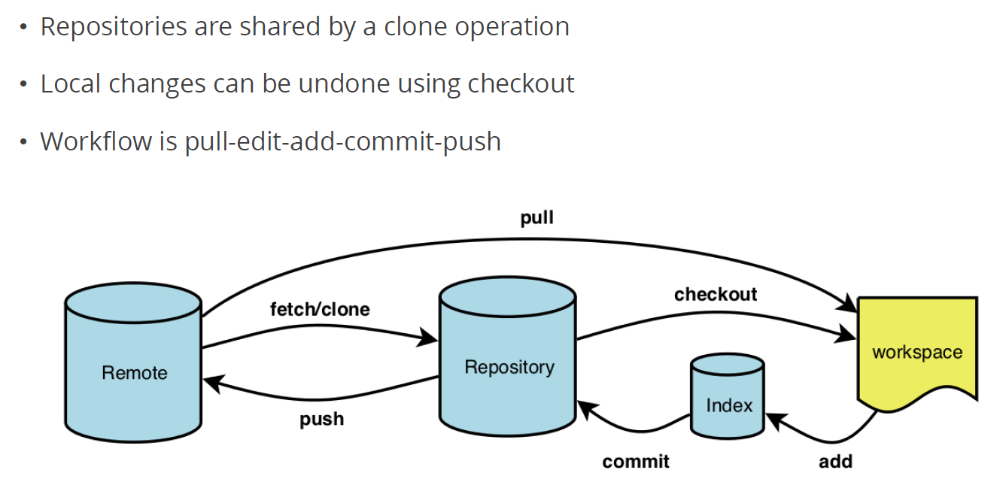
Git Workflow

Slide 23
Lab 6 – Collaboration

Slide 24
Group Assignment – GitHub
Team of 2
Team Leader and Team Members
Team Leader to create repo
Add Team Members as Collaborators
Team Members to clone repo
Create their own branch (use your name)
Create New File
Push to Their Own Branch
Create Pull Request
Team Leader to Merge

Slide 25
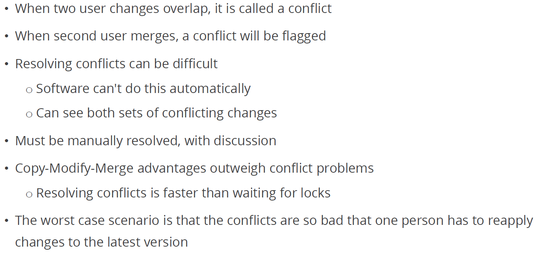
Conflicts

Slide 26
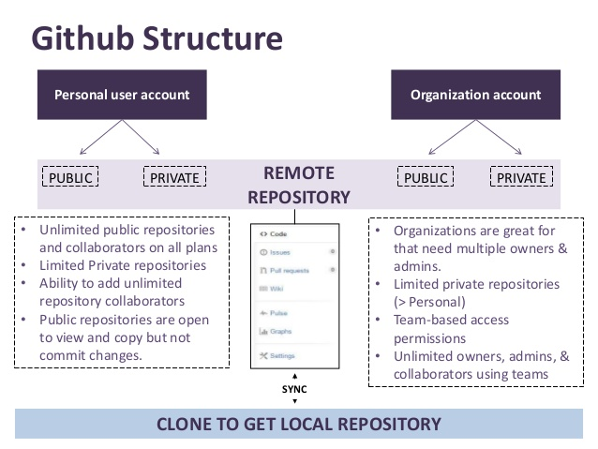

Slide 27
This concludes Chapter 3 Let us move to Chapter 4 CI-CD with Jenkins

